Slide 1



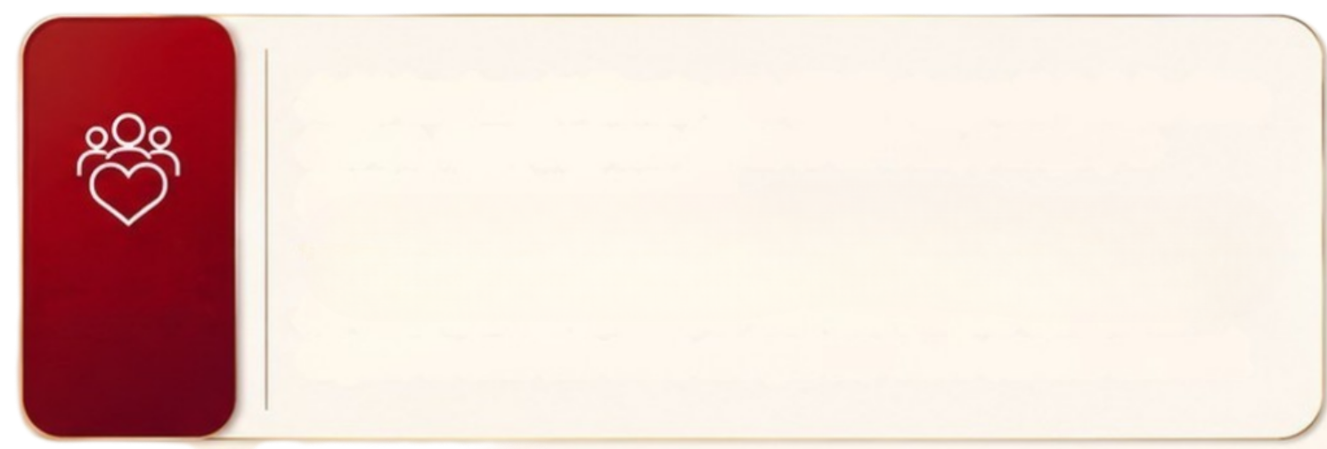

Customer testimonial:
Infinite Care
Infinite Care activated
on high value claim
(higher than SI without any limit)
Vishwas Salunkhe
Location: Pune
Sum Insured: 10L
with
Infinite
claim
10L
30L
Unlimited
30L
Claim
10L
Claim
Industry First
Vishwas has bought Elevate with 10L SI along with Infinite
Care add-on.
He was diagnosed with Guillain-Barré Syndrome (GBS) - a
rare auto-immune disorder. He was admitted on 2nd Sep’25
and the claim amount was 30.4L.
Additional value of 20.4L was paid due to the Infinite care
add on
Claim no
125000627500

Slide 2
In Box : Mention
Just 44 days after purchasing an Elevate policy with a ₹10 Lakh Sum Insured and Infinite Care add-on, 14-year-old Ms. Samhitha Krishnakumari was admitted with severe Viral Pneumonia, ARDS, Septic Shock, and Acute Kidney Injury requiring critical care.
Her treatment resulted in a hospital bill of ₹43.66 Lakhs, far exceeding the base Sum Insured.
With the Infinite Care add-on, ICICI Lombard settled ₹39.19 Lakhs, significantly minimising the family's out-of-pocket expenses and providing financial protection when it mattered most.
Headline :
Customer Testimonial: Infinite Care
On timeline:
Ms. Samhitha Krishnakumari (14 Years)
Claim Highlights:
Policy Age: 44 Days
Base Sum Insured: ₹10 Lakhs
Hospital Bill Amount on Timeline : ₹43.66 Lakhs
In circle: Infinite care activated on high value Claim (Higher than SI without any limit)
Paid by ICICI Lombard: ₹39.19 Lakhs
Under the Unlimited logo in right side
Foot Note: Claim No – 220101482986

